Slide 1
Python Packages

Slide 2
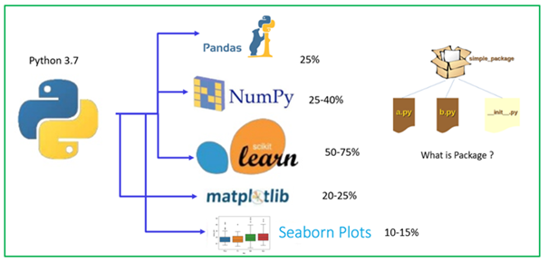
Data Science Packages

